Slide 1
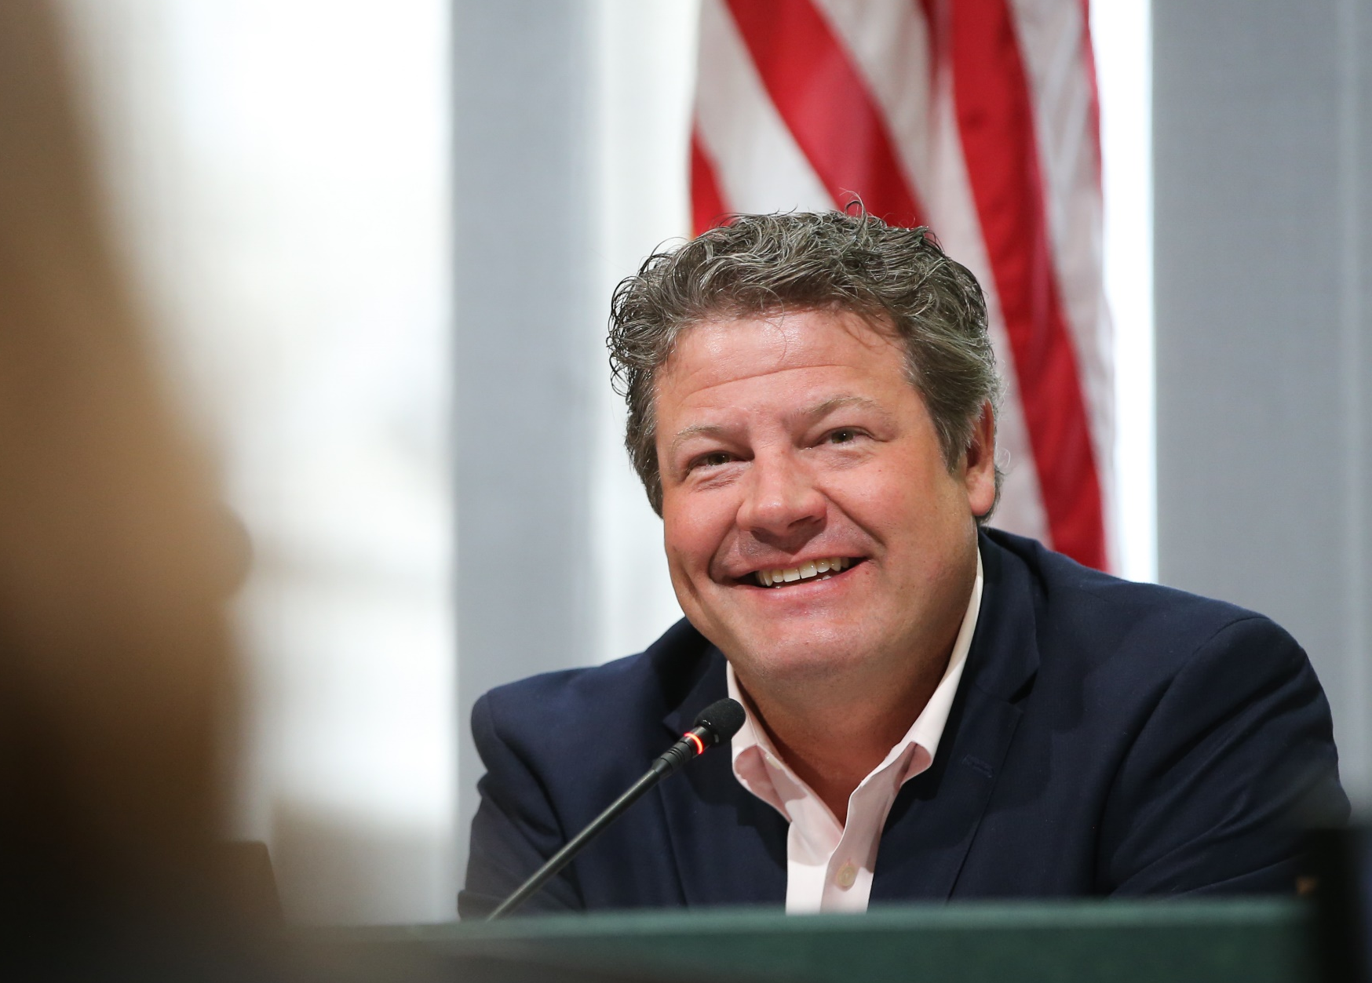
Newcastle City Council September 21, 2021
State of King County
King County Councilmember Reagan Dunn District 9

Slide 2
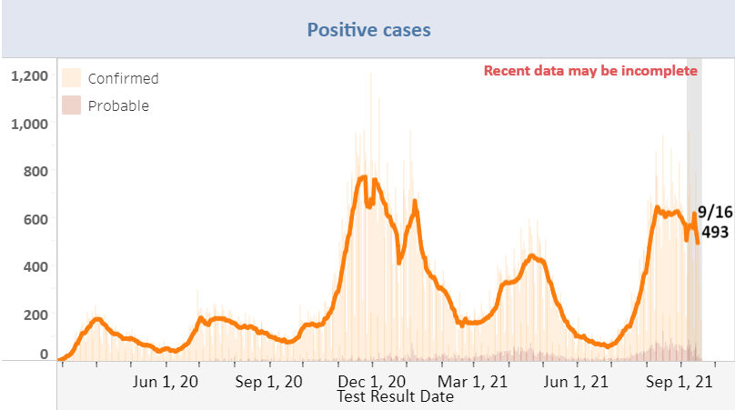
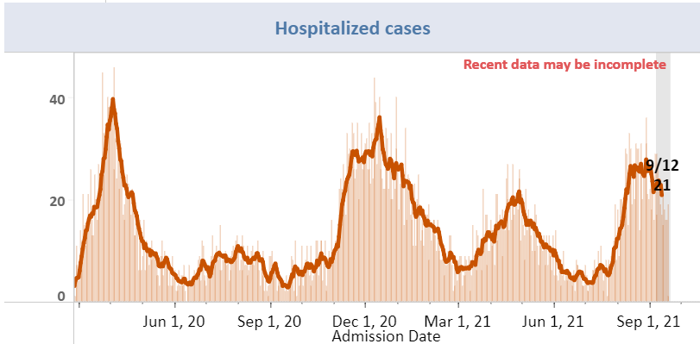
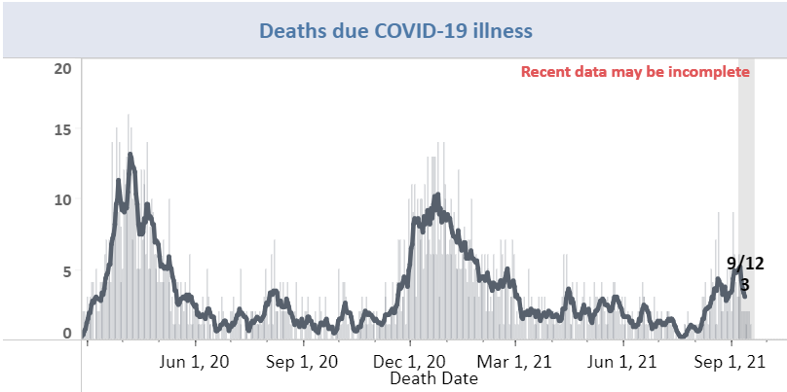
COVID-19 CASE UPDATE
Since July, we have seen a spike in new cases and hospitalizations due to the rise of the Delta variant.
Sept 20, 2021 | 7-day average | 14-Day Total
New Cases | 493 | 6,745
Hospitalizations | 22 | 237
Deaths | 2 | 28

Slide 3
COVID-19 CASE UPDATE
The risk of infection, hospitalization, and death is much higher among the unvaccinated.
In the past 30 days:
The majority of breakthrough cases are not serious and do not cause death or require hospitalization.
 | Vaccinated | Unvaccinated
Positive Cases | 31% | 69%
Hospitalizations | 17% | 83%
Deaths | 25% | 75%

Slide 4
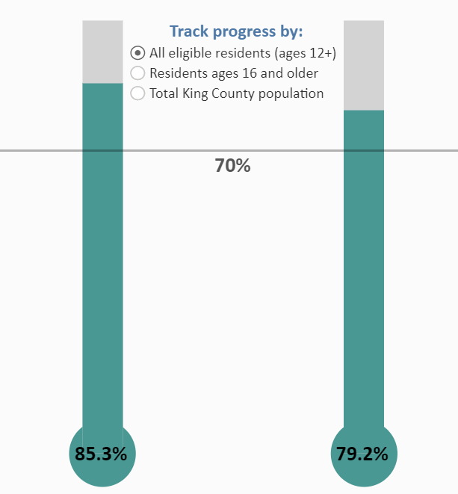
VACCINATION UPDATE
Goal: to vaccinate 70% or more of all adults across all demographics
Ages 12+ population = 1.95 million; 78.4% = 1.55 million
Numbers: As of September 19th, 3,143,794 doses of the vaccine have been administered:
1,670,712 King County residents have received one dose
1,552,166 have been fully vaccinated with two doses
22,962 have received a third mRNA dose
A third dose is recommended only for people with moderately to severe compromised immune systems.
Notes:
Most updated map/graphic to go here.

Slide 5
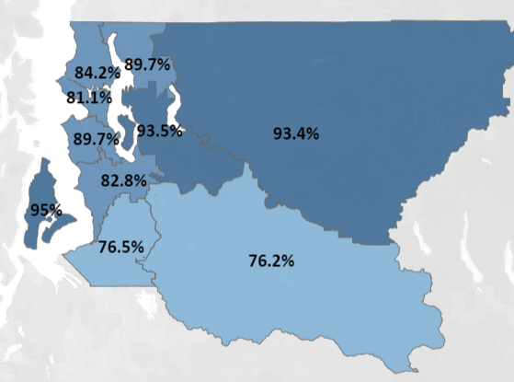
VACCINATION UPDATE, cont.
In Bellevue/Newcastle/Mercer Island/Issaquah, 93.5% of residents age 12+ have received at least one dose.
Current Vaccination Efforts: King County is administering a two-week moving average of 22,004 vaccine doses a week
What’s Next: King County will require verification of full vaccination status or a negative test to enter outdoor public events of 500 or more people and indoor entertainment and recreational establishments and events such as live music, performing arts, gyms, restaurants, and bars.
This goes into effect on October 25.

Slide 6
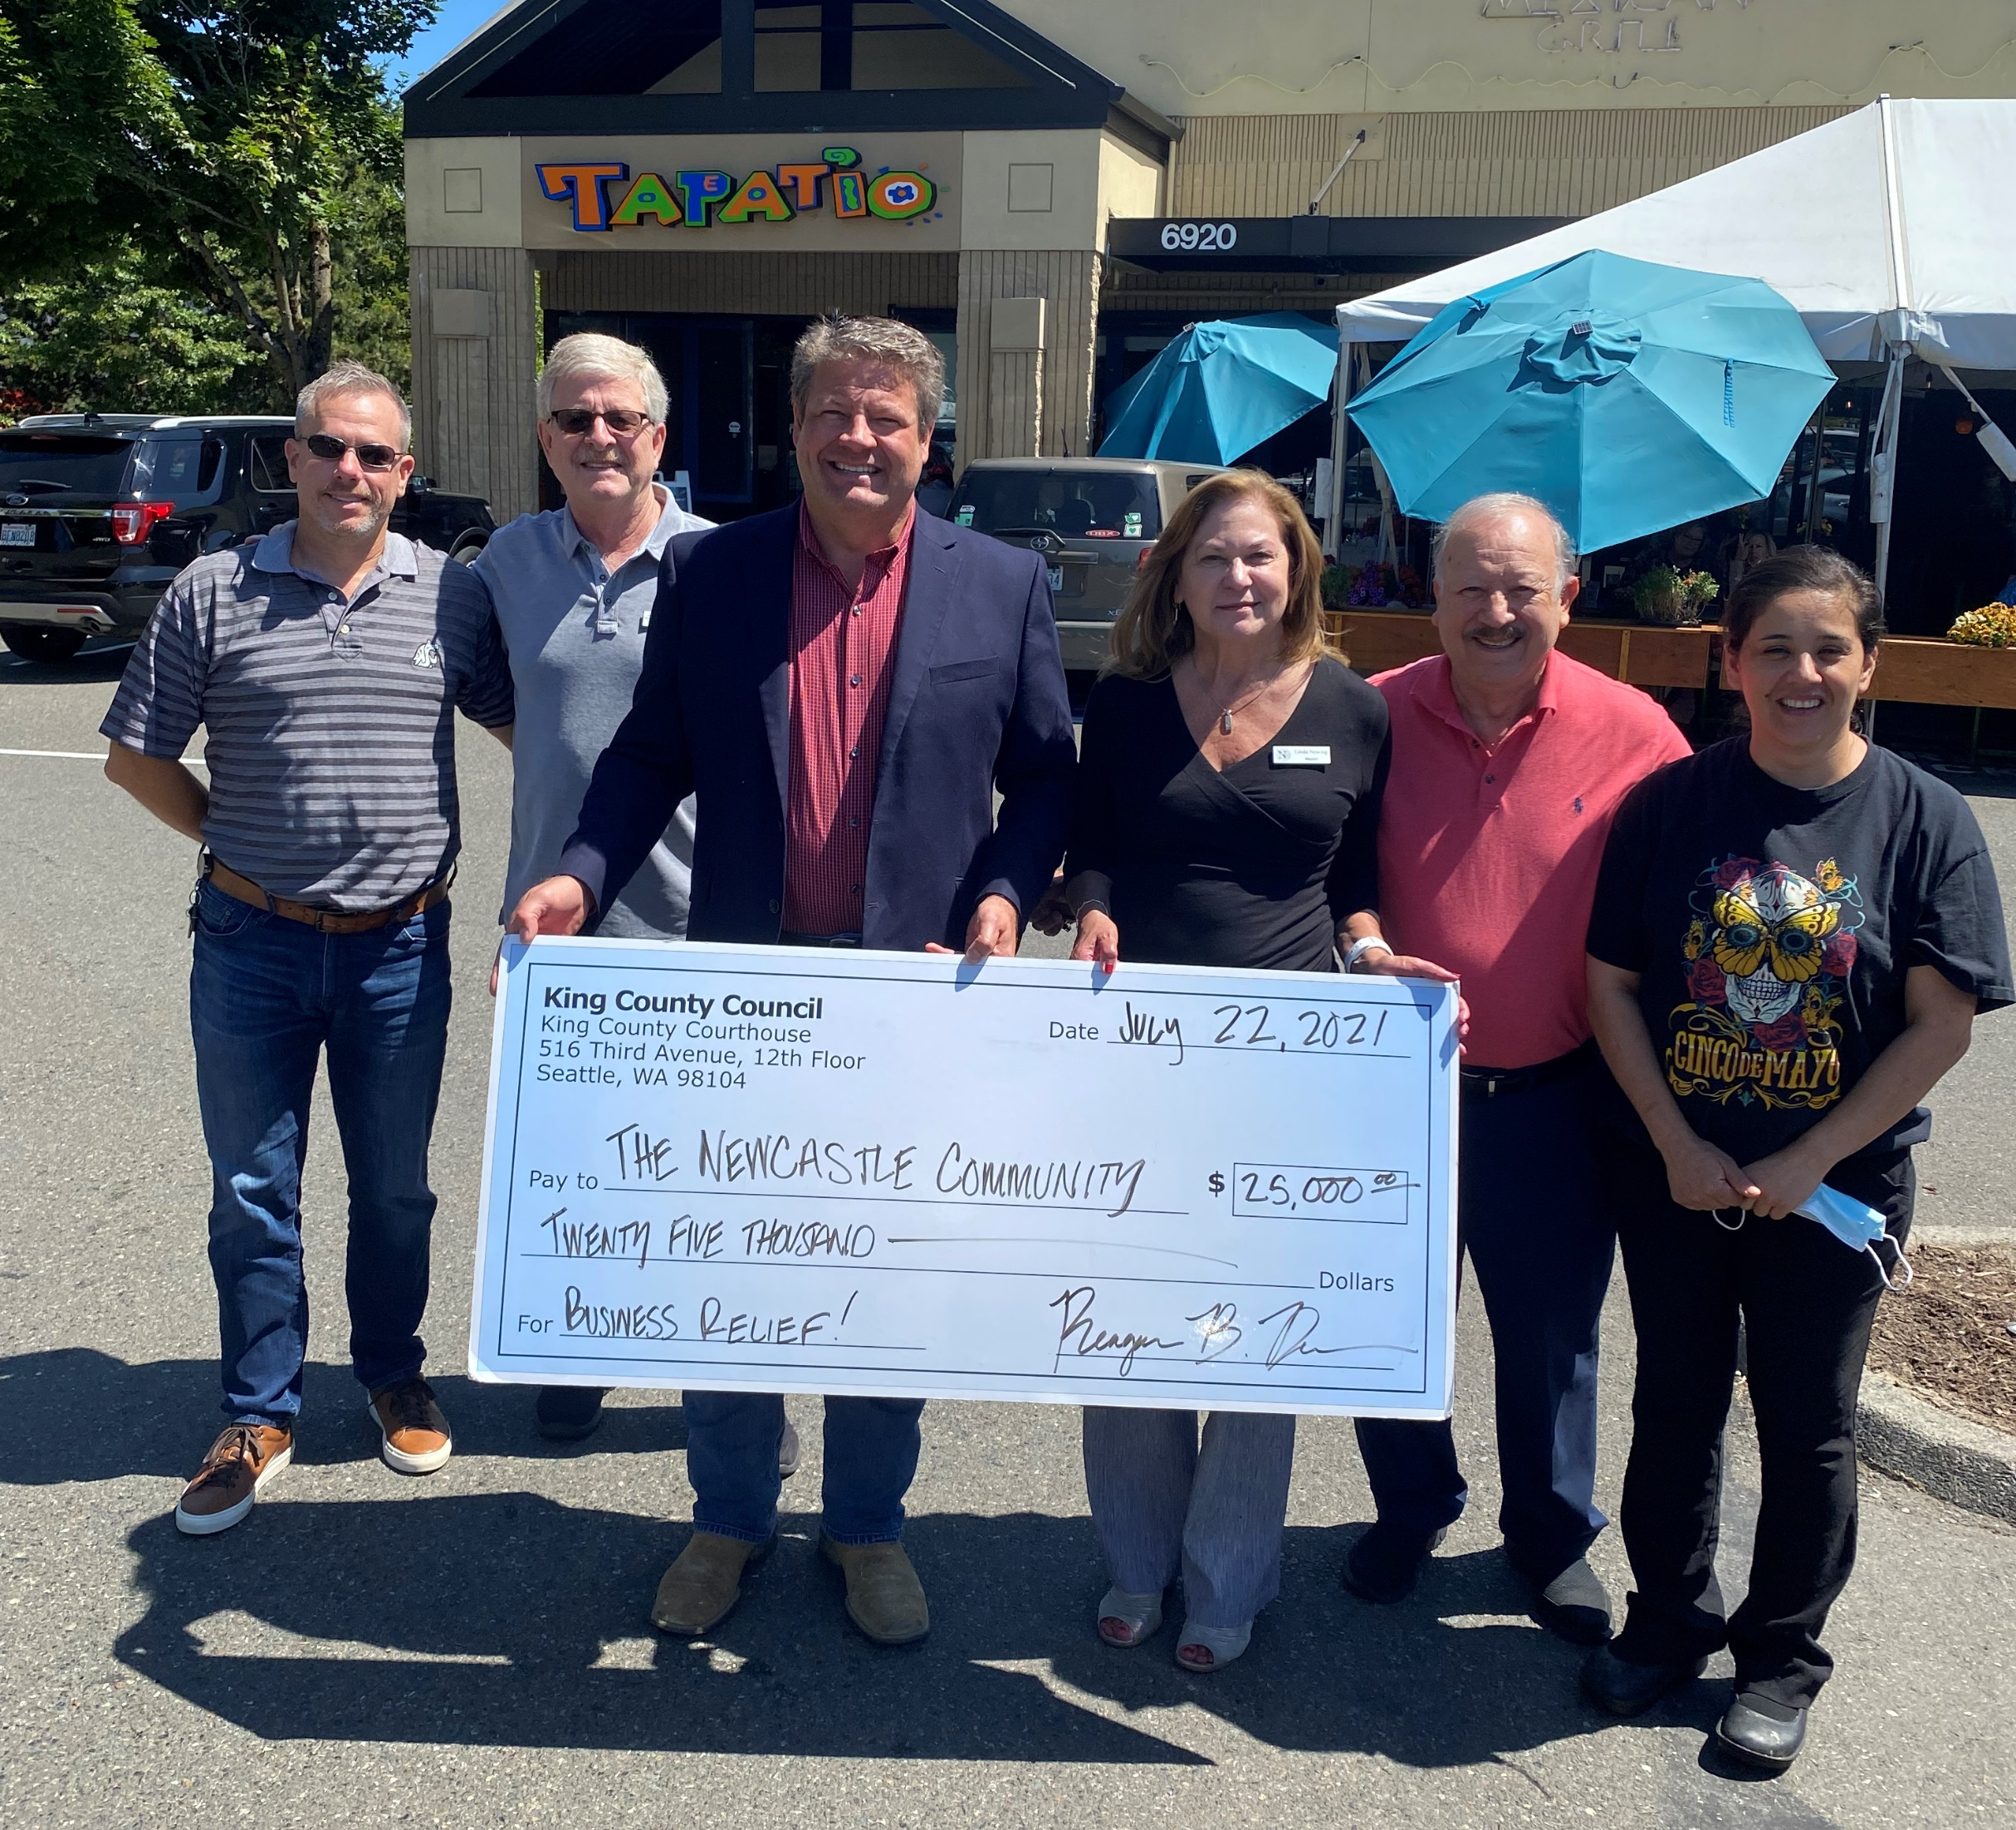
ECONOMIC RESPONSE
On July 27th, the King County Council approved its 8th emergency COVID-19 budget, totaling $389 million.
Highlights include:
Community supports (Eviction prevention, community development grants, HOME grants, immigrant community supports, civil legal aid, tiny house villages): $283.3 million
Legal System Backlog: $42.5 million
Public health response: $25.9 million
Vaccination efforts: $27.7 million
Economic recovery/workforce development: $5.6 million

Slide 7
EVICTION PREVENTION & RENTAL ASSISTANCE
In August, the Seattle Times reported that King County’s Eviction Prevention and Rental Assistance (EPRAP) program was lagging behind on its payments of federal rent assistance dollars to tenants and landlords who need financial aid during the COVID-19 pandemic.
As of August 18, King County had distributed just $6.5 million, or 4.5%, of $145 million in available federal funding.
Delay was due to the long the process of building a new data system to manage the federal funds, along with new federal requirements for verifying tenant and landlord information.
Legislation - In order to expedite the distribution of rent assistance, I introduced legislation requesting King County to report on the delays and make recommendations to expedite their process.

Slide 8
EVICTION PREVENTION & RENTAL ASSISTANCE, cont.
As of August 31, 2021, $22.6M in rental assistance had been distributed, serving 3,404 households; King County anticipates the ability to process $6million weekly
King County simplified the application and approval process for EPRAP and incorporated several changes in response to amended guidance received from the U.S. Department of Treasury in order to expedite the aid:
Tenants may now self-attest to income, housing instability and financial impacts due to COVID-19.
Landlords may now self-attest as to leases and ledgers to satisfy those requirements for each tenant and keep the approval process moving.
EPRAP is now able to advance payments to property owners and landlords based on the estimated total amount due, paying up to 50 percent of the estimated bulk payment in anticipation of full satisfaction of the application requirements.

Slide 9
KING COUNTY REGIONAL HOMELESSNESS AUTHORITY
King County Regional Homelessness Authority (KCRHA) – Established in December 2019 to unify and coordinate the homeless response system for Seattle and King County.
Scope: coordination of all outreach, diversion, shelter, rapid re-housing, transitional housing and permanent supportive housing services and most of the region’s prevention efforts.
Update: The KCRHA has hired CEO Marc Dones and other key leadership positions. Staffing plan has been approved, and they currently have roughly 10 employees.
Next steps:
Subregional planning – Alexis Mercedes Rinck was hired from the SCA to do the subregional planning work, and she has connected with over 140 organizations/individuals to help inform the subregional plan.
Taking over provider contracts – KCRHA is working on transitioning Seattle and King County’s service provider contracts by January 1, 2022.

Slide 10
HOMELESSNESS LEGISLATION
Repurposing City Hall Park:
After legislation to condemn City Hall Park and public outcry from Judges and employees, City Hall Park was cleared of homeless encampments.
This legislation would explore a land swap with the City of Seattle, so City Hall Park would be controlled by King County and brought into the downtown County Campus.
Status: In Committee
Creating homeless outreach teams:
Creates homeless outreach teams to connect the homeless in unincorporated King County with services and shelters.
Status: In Committee
Creating standards for clearing homeless encampments:
King County lacks guidelines for when and how to clear homeless encampments in unincorporated King County.
The goal is to create standards for how to respond to homeless encampments.
Status: In Committee

Slide 11
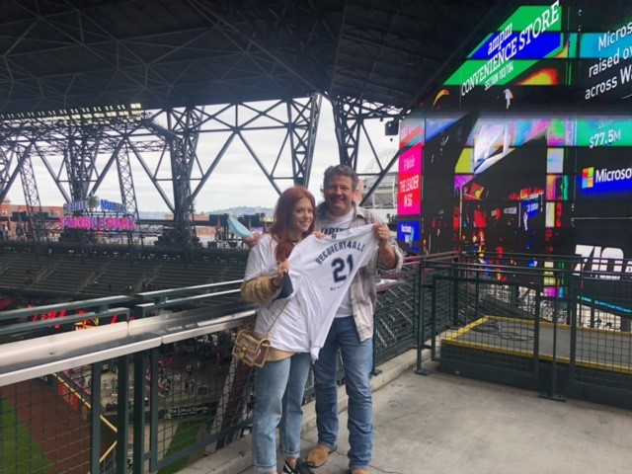
SUPPORTING ADDICTION RECOVERY AND MENTAL HEALTH
Conference on Addiction Disorders:
Hosted King County’s first conference on addiction and recovery, attended virtually by 200 people.
Protecting Virtual Recovery Meetings:
Sponsored legislation to create a civil penalty for unauthorized recording or hacking of online recovery meetings.
Funding for Recovery Café:
Delivered $500k to support Recovery Café’s services for those in recovery.

Slide 12
PUBLIC SAFETY
Violent Crime on the Rise: 2021 is on track to be a record year in gun violence and homicide.
1,025 Shots Fired in 2020 – 19% increase compared to the three-year average of 870 shots fired.
580 shots fired in Q1-Q2 in 2021, up 33% from the 3-year average.
337 shooting victims – 36% rise in shooting victims in from the three-year average
196 shooting victims in Q1-Q2 of 2021.
95 homicides – Homicides and murders have spiked 86% over the past three years, increasing from 51 homicides in 2018 to 70 homicides in 2019 and 95 homicides in 2020.
There have been 101 potential homicides so far in 2021.
* “other felonies” include less serious violence and economic/property offenses, some burglaries and car thefts

Slide 13
KING COUNTY SHERIFF’S OFFICE UPDATE
Appointing a New King County Sheriff
The Executive’s Public Safety Advisory Committee (PSAC) will report recommendations to the Council on September 30th.
Once the report is submitted, the Executive will take the recommendations from the PSAC regarding what qualities the next Sheriff should have and begin a search for candidates meeting those recommendations.
The Executive will appoint a final candidate and the Council will confirm.

Slide 14
PUBLIC SAFETY LEGISLATION
Officer Wellness Program:
Requests a report to the Council on the effectiveness of the KCSO wellness program after its first year and funding for a full-time program coordinator position
Goal is to highlight the importance of this program and encourage making it permanent
The program supports deputies in coping with stress, substance use recovery, and mental health in order to improve on-the-job performance
Status: Deferred in committee
KCSO Recruiter Position:
Sponsored funding for to hire a recruiter to fill vacant deputy positions
Currently, KCSO has 54 vacant positions
Status: Approved in the COVID 8 supplemental budget
Hate Crime Hotline:
Creates a workgroup to build and launch a non-police hotline and reporting system that would allow King County residents the ability to report these incidents
The proposed Stop Hate Crime Hotline received $150,000 in funding in the first omnibus supplemental budget passed by the County Council in late June.
Status: Has passed committee and will be sent to the full King County Council for a final vote

Slide 15
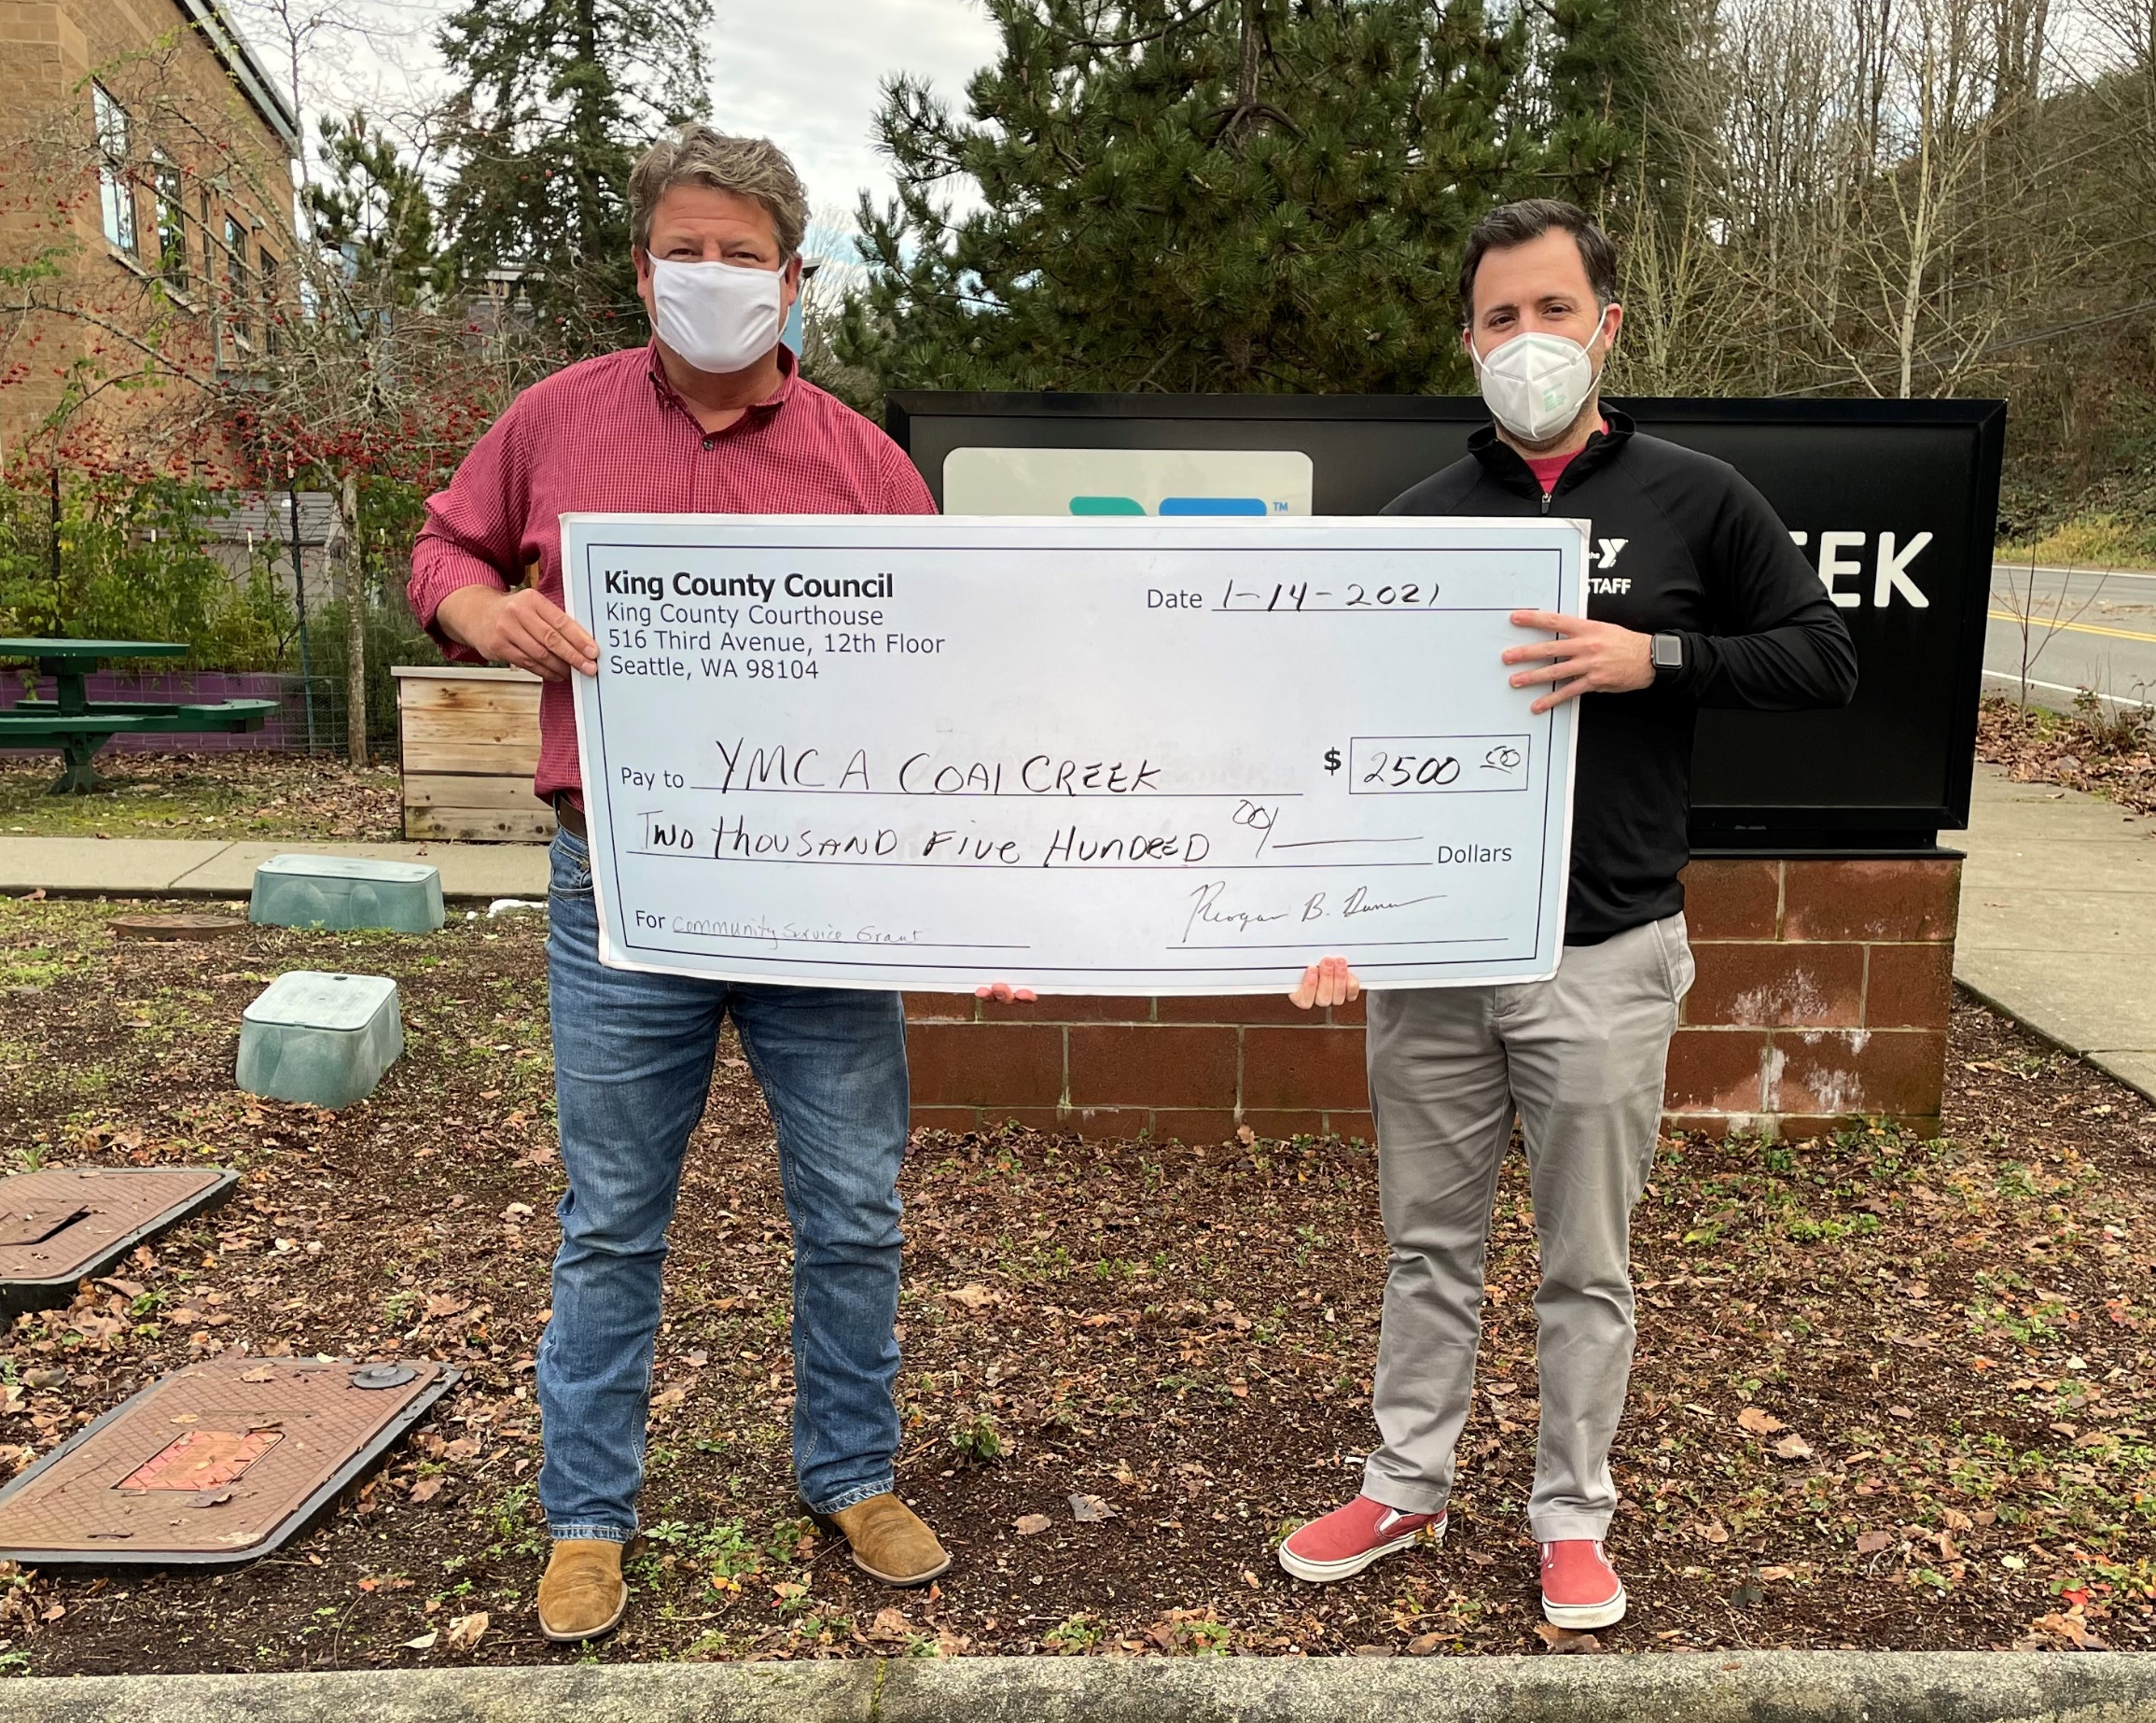
INVESTING IN NEWCASTLE
2021 Grants
$5,000 Youth and Amateur Sports Grant for the City of Newcastle
$2,500 grant to the Coal Creek Family YMCA
$25,000 grant to the Newcastle Chamber of Commerce
$25,000 grant to the City of Newcastle for restaurant relief
$2,500 grants to Local Schools Foundations
$5,000 grant to the Newcastle Baseball League
$25,500 grant to King County Housing Authority

Slide 16
Contact
Reagan.Dunn@KingCounty.gov
Twitter: @KCCReaganDunn
Facebook: @councilmemberreagandunn
Sign up for email updates at kingcounty.gov/council/dunn
King County Councilmember Reagan Dunn District 9

